Slide 1

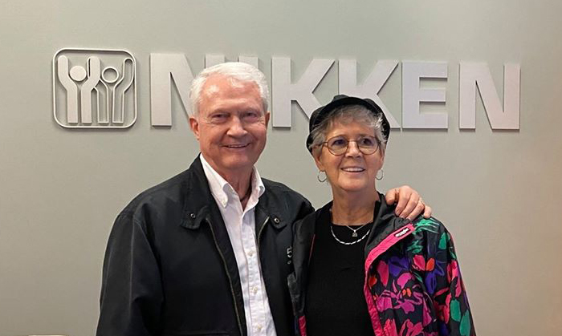

Slide 2




NIKKEN® Discover It. Live It. Share It
NIKKEN- “We Can Help” when You hurt.
What did for the Computer &
did for the Phone
NIKKEN has done for Our Health
Countless BILLIONS of $ have been spent to study our SICKNESS
Almost NOBODY has studied our HEALTH
NIKKEN has spent over 4 DECADES doing exactly that…
We are ready to share our answer with the world.
Beginning Here… Now… with YOU

Slide 3

NIKKEN® Discover It. Live It. Share It
Who Is Nikken®?
A Research & Development Company founded in 1975 to study, and then solve, how to make our lives better. We have done BILLONS in GLOBAL SALES on 5 CONTINENTS, all WORD OF MOUTH, and have impacted MILLIONS of lives. But that is just a start, NIKKEN is ready for MORE!
NIKKEN combined over 4 decades of wisdom with cutting edge vision and is actively launching the Next Phase of this Iconic Company’s Plan.
We will soon become a household name. Let’s show you how we will do it!

Slide 4

NIKKEN® Discover It. Live It. Share It
Let us introduce you to the LIFE CHANGING IDEA of a BALANCED LIFE with “NIKKEN’S 5 PILLARS OF WELLNESS”
“The Nikken Plan” is designed to help you achieve these 5 Pillars.
It is setup so that anyone, with any schedule or background, can make a Balanced Life a reality
We are not talking about simply making a living…. or not being sick…
We are talking about BUILDING A LIFE so you can live our Core Mission of “Humans Being More”

Slide 5




NIKKEN® Discover It. Live It. Share It
The Foundational First Pillar: “HEALTHY BODY”
THE NIKKEN WELLNESS HOME:
Science to Replicate Nature so you can be “Be Healthy By Choice Not By Chance”
The Antidote to our “TOXIC WORLD” & the “SICKCARE SYSTEM” that is feeding on it
Many companies have pieces of Wellness -only NIKKEN® has it all for a “Wellness Home”

Slide 6
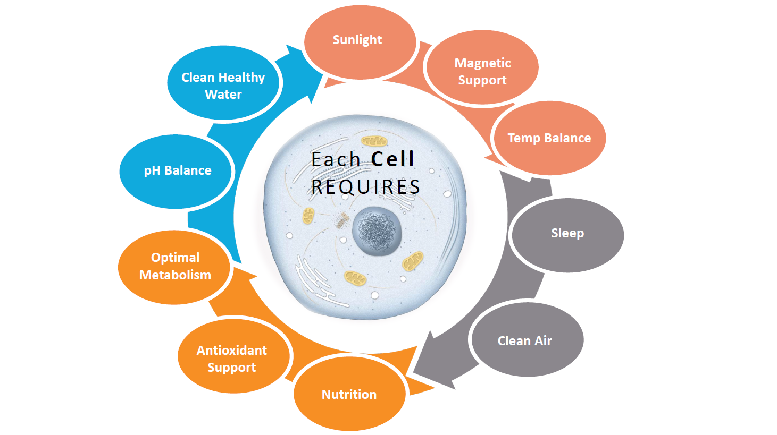

Slide 7
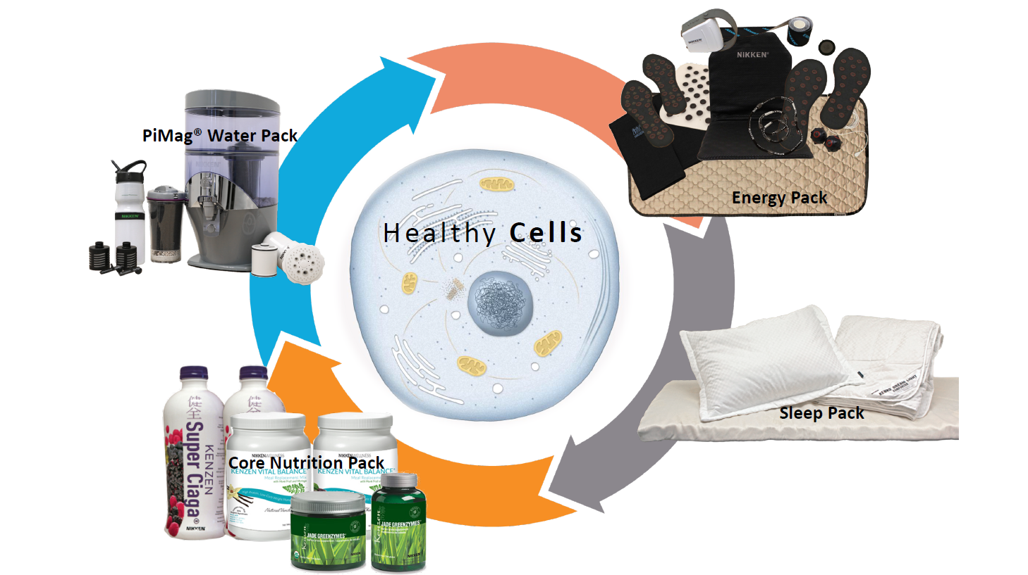

Kenko Air Purifier

Slide 8


NIKKEN® Discover It. Live It. Share It
Nikken® Makes Being Healthy Simple, Convenient and Affordable
Our Products are designed to:
Keep the “bad things” out
Put the “good things” in so you can BE MORE!
Whether you are an elite athlete, struggling with health issues or somewhere in between, our products give our bodies what they need to be at their best
Be the highest in quality yet still be supremely affordable
Require no training or expertise to use- if you can sit, stand, lay down, or read a label you are a “Nikken Expert”
The Choice of Healthcare vs “Sickcare” for Yourself and those
You love is in YOUR HANDS with NIKKEN

Slide 9


AHEAD
Disclaimer
The Question on the next slide may be the most
important one you have NEVER been asked!

Slide 10
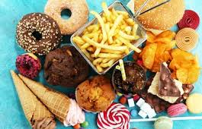



NIKKEN® Discover It. Live It. Share It
Is there more to Health than just Physical?
Are Our Lives Making Us Sick?
How much is our health affected by:
Job Stress
Financial Stress
Time Stress
Poor food choices due to time or budget
Inability to exercise due to job
Medical or drug costs impacting the budget
Medical treatment or Prescriptions NOT done or used due to budget
Lack of social activities or doing things we love
Physical Wellness & Financial Wellness are INSEPARABLE.
Let’s show You the FULL POWER of NIKKEN!

Slide 11
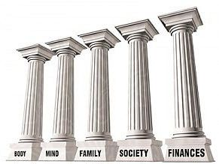



NIKKEN CAN HELP!
The Pathway To A Balanced Life
The 1st and 2nd Pillars :
Healthy Body & Finances
Open the door to the other 3:
Healthy Family, Society & Mind
Which deliver the Nikken Mission of a
Life in Balance & Humans Being More
YOUR NIKKEN® CHOICES
Connect For
Active Wellness
Upgrade to earn income by connecting customers
Create a Reproductive Income with
“The Nikken Plan”
We have full support to help maximize the Nikken Experience that is right for You
The POWER of NIKKEN INTERNATIONAL will be with you all the way!

Slide 12

NIKKEN® Discover It. Live It. Share It
Second Pillar: Healthy Finances
Sharing the gift of WELLNESS To Create WEALTH
Nikken has combined the best parts of each type of business:
    Major Corporation
    Franchise
    Networking Company
To Create a Revolutionary First True Home Career
No matter your age, background or circumstances, it’s a chance for a “New Beginning”
You are in business for yourself but not by yourself… and we have fun doing it together!
We do not get paid on “sign-ups”, training, events or tools. We only get paid when YOU do!
FINALLY… Someone Got The Home Business RIGHT!
A Business Built FAST & Built To LAST

Slide 13
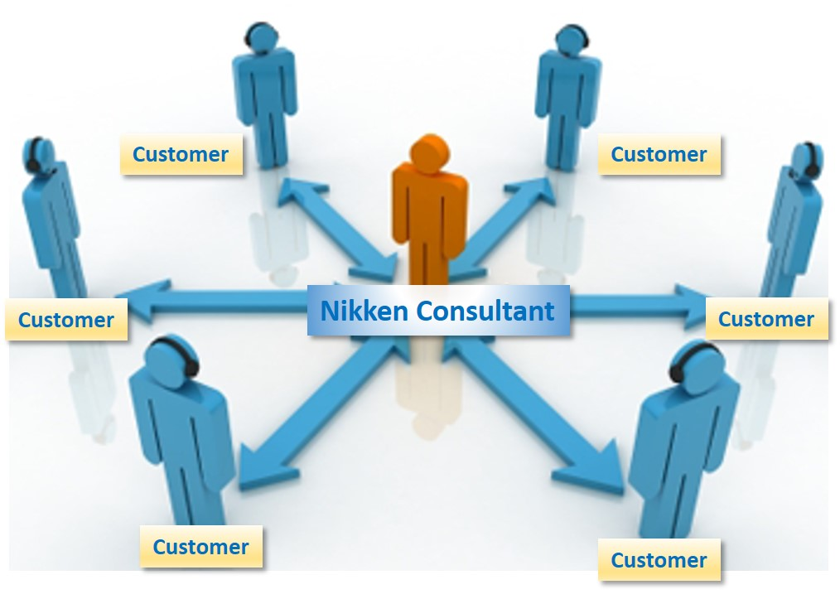
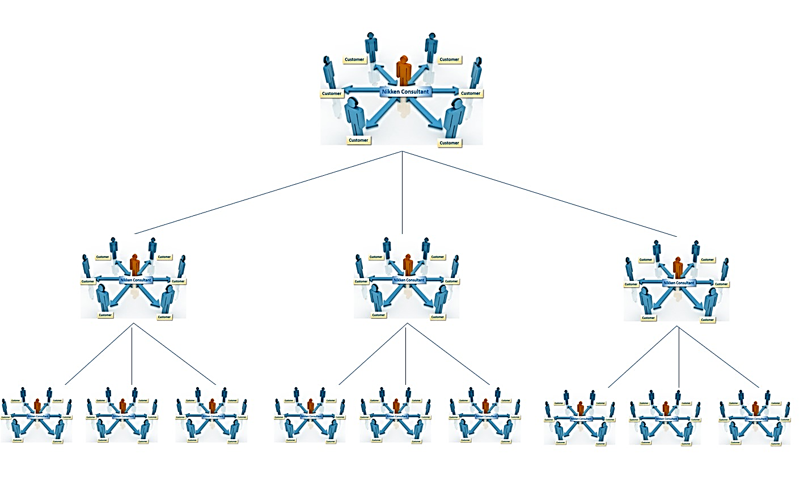
NIKKEN® Discover It. Live It. Share It
Putting “Health & Wealth” Together to create FREEDOM
Getting Started is SIMPLE, FUN & FAST:
You can upgrade to Nikken Prime for only $99 + tax
Connect to get healthy & help others access our products
Teach 3 To Reach 3 to do the same
Duplicate- You will be paid as your team duplicates Globally!
Leveraged Sales

Slide 14



NIKKEN® Discover It. Live It. Share It
NIKKEN HUMANS BEING MORE
Don’t Live Just a Life… Live An Adventure!
Heathy, Wealthy & Free!

Slide 15
